Slide 1
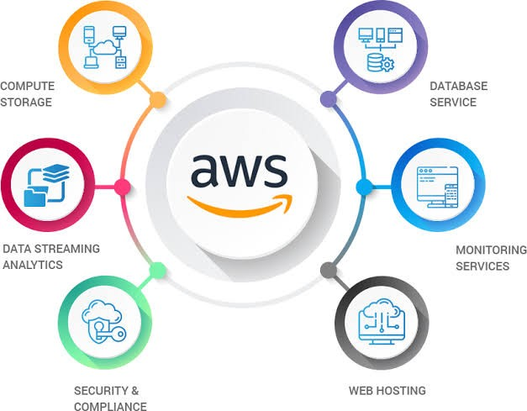
Cloud Basics
AWS
What is AWS?
It stands for Amazon Web Service. AWS is the most dominant cloud service provider in the world today, representing 41.5% of all application workloads that exist in the cloud and a 30% market share.
AWS features a versatile range of product offerings such as, Infrastructure-as- a-Service (IaaS), Platform-as-a-Service (PaaS), and Software-as-a-Service (SaaS)

Slide 2
AWS Global Infrastructure
Internet
IG
VPC
1
2
3
Region
X
E
Z
VPG
Corporate
N/W
Y
F
Subnets
A
B
C
Availability Zones
Instances

Slide 3
AWS monitoring vs. observability
Monitoring
Monitoring, by definition, is the process of collecting, analyzing and using data to track various systems.
To get notified about the issue by collecting and analyzing.
1. Notifies about the
problem
Observability
Observability leverages all of the data from logs, metrics and traces to help development teams detect and resolve any issues.
While to remove the issue and getting the main cause we need proper data, here observability comes in the picture.
Monitoring
Observability
2.Details about the problem
Observability is a broader concept that includes monitoring

Slide 4


CloudTrail vs. CloudWatch
CloudTrail is a service which focuses on the actions performed inside the AWS environment.
It is mainly focused on the user activities inside the account.
CloudTrail is basically who, what, when & where .
Delivers an event within 15 mins of the API call.
CloudWatch is a service which focuses on the health and performance of AWS resources.
It is mainly focused on the AWS resources, services
It helps collecting and tracking metrics, log files & setting alarms
Delivers an event within 5 minutes or 1 minute

Slide 5
EC2 Instance Launch type
On-Demand Instance
You pay what you use.
No long term commitment.
You decide when to launch, stop, hibernate, start, reboot, and terminate it
Use Cases:
Short term, irregular workloads that can be interrupted
Reserved Instance
Provide a significant discount (up to 72%) compared to On-Demand Instance.
Tenure : 1 to 3 years.
Use Cases:
Are used for stable predictive workload.
Spot Instance
Unable you to use unused EC2 instances at steep 90% discount (Most Cost Effective).
Taken back from you, if someone pay more
Use Cases:
Best used for interrupted work loads which are resilient to failure
Batch jobs
Image processing

Slide 6
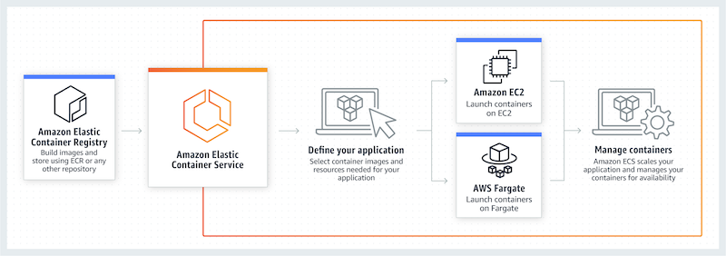
AWS- ECS(Elastic Container Service)
Amazon Elastic Container Service is a fully managed container orchestration service offered by Amazon AWS. The primary use cases for ECS, include managing microservices and handling batch jobs.

Slide 7
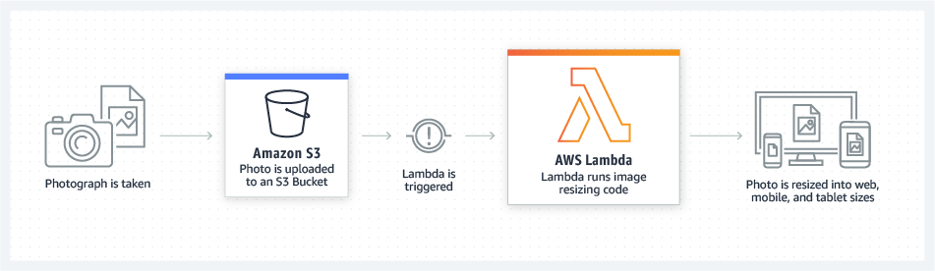
AWS Lambda
The service enables you to upload your code — called a Lambda function — and configure it to execute under certain circumstances.
Your don't need to worry about the backend and the storage problems or anything for your application or code, you just write a code and provide it to Lambda.

Slide 8
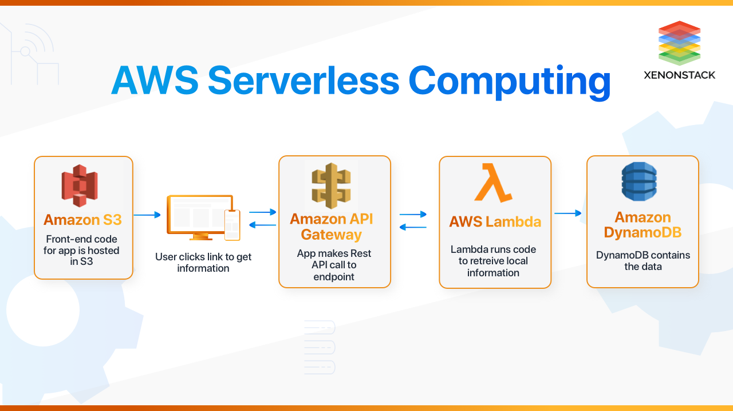

Slide 9
Amazon Inspector
Amazon Inspector is a security assessment tool for AWS that allows users to perform automated security assessments of applications deployed in AWS environments. AWS inspector detects anomalies or variations from baseline activity or traffic levels, generating alerts that can be investigated from within the service or aggregated into the AWS security hub service along with security data from other services.
AWS cloud HSM
HSM (Hardware Security Module)
Process cryptographic operations.
Provide storage for cryptographic keys.
AWS cloud HSM - Helps in generate and use you encryption keys

Slide 10
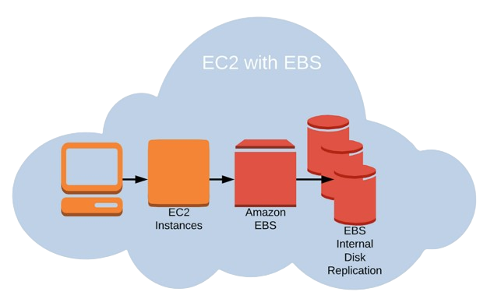
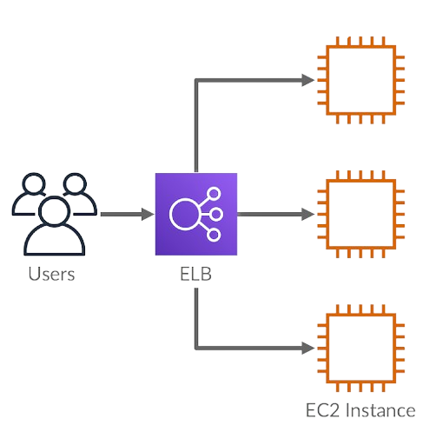
Elastic Block Storage (EBS)
EBS works in EC2 which provide data storage volume that divide and replicate to multiple levels of hierarchy
A block storage system used to store PERSISTANT data (big data use for long period of time)
Elastic Load Balancing (ELB)
Classic Load Balancing. This more closely resembles traditional load balancing, but virtual devices replace physical hardware to evenly distribute your incoming requests and ensure a clean, fast user experience.

Slide 11
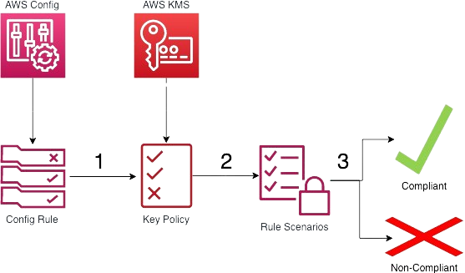
AWS CloudFront
CloudFront is an AWS service that allows businesses to deploy content with low latency and high data transfer speeds. This allows end users to get an immediate response from the website as soon as they search for information.
AWS Config
AWS Config Rules are a form of AWS monitoring for managing configuration changes in an automated manner.
AWS Config Rules make it easier for you to manage compliance within your environment and stay up-to-date with configuration changes as they are introduced.

Slide 12
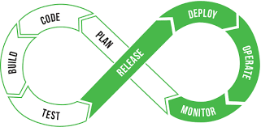
DevOps
DevOps, short for Development and Operations, is a set of practices, principles, and cultural philosophies that aim to improve collaboration and communication between software development (Dev) and IT operations (Ops) teams.
DevOps Processes provide such a culture allows fast, efficient, reliable software delivery through production
The goal of DevOps is to streamline the software delivery lifecycle, enhance the quality of software releases, and increase the overall efficiency and effectiveness of the development process.

Slide 13
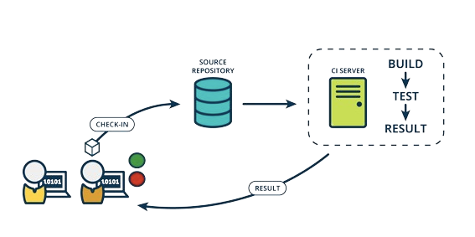
c
Continuous Integration
Continuous Deployment
Continuous Delivery
Application test
DevOps CI/CD pipelines
Application test
Deploy to Production
Post deploy test
Deploy to Production
Post deploy test
Auto
Auto
Manual
Auto
C
Deliver to staging
Unit test
Platform test
Deliver to staging
Unit test
Platform test
C
Auto
Auto
Auto
Auto
C

Slide 14
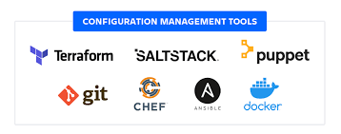
CONFIGURATION MANAGEMENT
A set of practices, processes, and tools that help in systematically managing and maintaining the state of an organization's infrastructure, software, and systems.
Defining, controlling, releasing, changing, documenting and reporting the configuration of items in a system

Slide 15
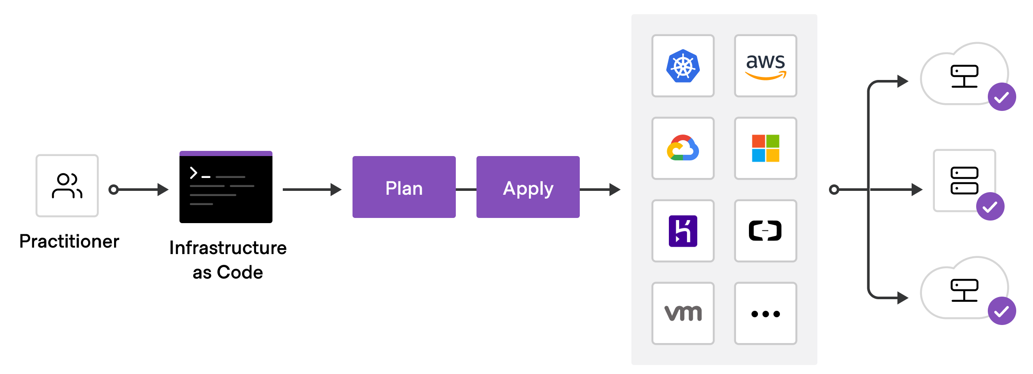
Infrastructure-as-Code (IAC)
Infrastructure as Code involves code to provision, configure, and manage infrastructure. Use the right set of tools to describe the infrastructure on which the application deploys.
DevOps writes down the application code plus configuration management-related instructions to trigger actions from the virtualization and other environments like the database, appliances, testing tools, delivery tools, and more.

Slide 16
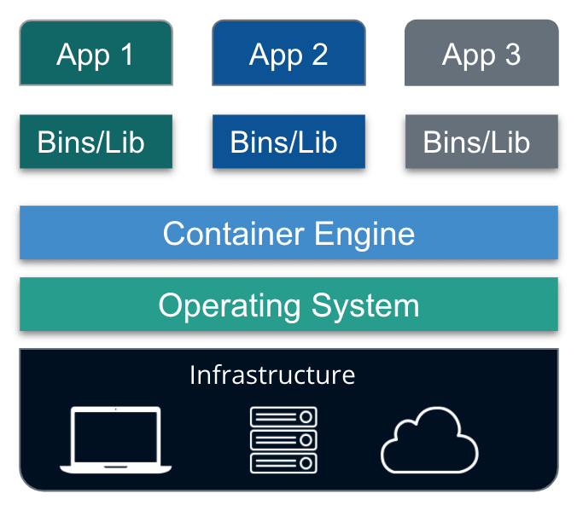
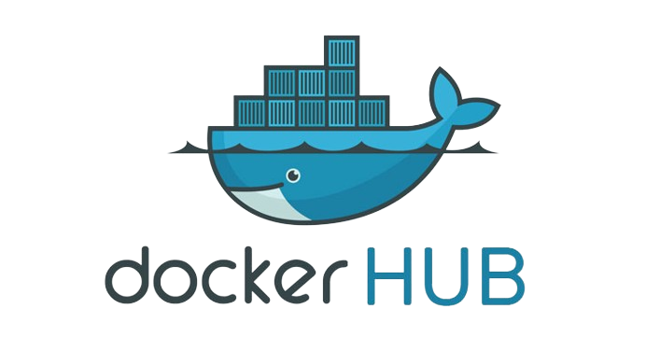
Microservices
An architectural style of developing a complex application by dividing it into smaller modules/microservices. With Microservices, developers can decide how to use, design, language to choose, a platform to run, deploy, scale, etc.
Docker Container

Slide 17
Kubernetes (K8)
(K8) is used to orchestrate
containerized cloud-native microservices apps
orchestrate
Manage your application
containerized
Deploy your application
Self Healing
There is world outside of Docker
Scale it up or down
Rolling updates and rollbacks
Apps that run in container
cloud-native
microservices
Authentication service
An Application built from lots of independent small specialized parts that works together.
Video conversion
An application that is designed to meet cloud demands like auto-scaling, self healing, rolling updates and rollbacks.
Video streaming
Discussion section
Certificate

Slide 18
Blue/Green
Deployment
Ramped
Deployment
Strategies
for
Application
Deployment
Recreate Deployment
Canary
Deployment
A/B testing
Deployment
Shadow
Deployment

Slide 19
Important Linux Commands
1. ssh – Stands for Secure Shell, it is used for securely accessing and managing remote servers and network devices.
Example: sudo ssh –i “TWS-key.pem” username@remote-server
2. scp - Stands for Secure Copy, and it is a command-line utility for securely copying files and directories between hosts over an SSH (Secure Shell) connection.
Example:
a. From local to server:
sudo scp –I “TWS-key.pem” filename.type username@remote-server:/path/to/destination/
b. From server to local:
sudo scp –I “TWS-key.pem” username@remote-server:/path/to/remotefile.txt /local/destination/

Slide 20
Important Linux Commands
3. awk is a powerful programming language and command-line utility in Unix and Unix-like operating systems for processing and analyzing text data.
Example: awk 'pattern { action }' input_file
4. cron is a time-based job scheduler in Linux. It allows users to schedule and automate the execution of tasks or commands at specified intervals
Example: m h dom mon dow command > path/of/filename.type
m: Minute (0 - 59)
h: Hour (0 - 23)
dom: Day of the month (1 - 31)
mon: Month (1 - 12)
dow: Day of the week (0 - 6, where 0 is Sunday)
command: The command to be executed

Slide 21
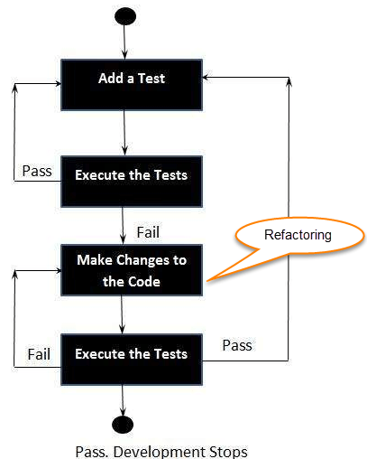
Test Driven Development
RED
Write a Test case which fail
GREEN
Write the simplest possible code to make it succeed.
REFACTOR
Refactor the code to meet the “4” principles of simple design.
Runs all tests
Contains no duplication
Expresses intent of programmers
Minimizes number of classes and methods
Repeat

Slide 22
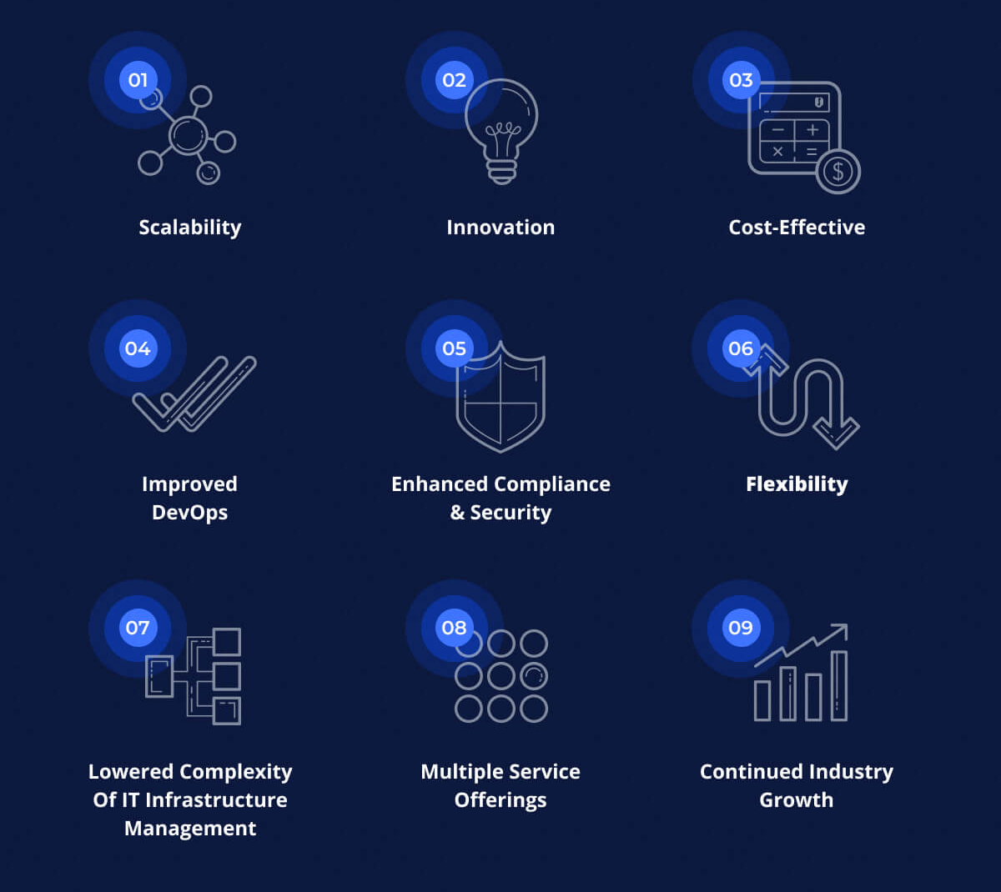
Reasons Why Cloud Computing Is Important for Business Growth

Slide 23

Benefits of Business Analytics
Data-driven decision-making
Improved operational efficiency
Better customer insights
Competitive advantage
Predictive modelling

Slide 24
Open Web Application Security Project (OWASP)
Broken Access Control
Cryptographic Failure
Injection
Insecure Design
Security Misconfiguration
Vulnerable and Outdated components
Identification and Authentication failure
Software and Data Integrity Failures
Security Logging and Monitoring Failures
Server-Side Request Forgery

Slide 25
Concurrency
Scale out via the process model
Port Binding
Export services via port binding and it is self contained
Codebase
One codebase tracked in revision control & many deploys
Config
Store config in the environment
Logs
Treat logs as event streams
Processes
services are stateless and share-nothing
Disposability
Maximize robustness with fast startup and graceful shutdown
12
Factors
Dependencies
Explicitly declare and isolate dependencies
Build, release, run
Strictly separate build and run stages
Admin Processes
Run admin/management tasks as one-off processes
Backing services
Treat backing services as attached resources
Dev/prod parity
Keep development, staging, and production as similar as possible

Slide 26
#Customer Satisfaction
#Measure the Progress
1
7
2
#Accept Changes in requirement
#Sustainable Development
8
#Delivery value frequently
#Technical Excellence
3
9
#Work together
#Keep the work simple
4
10
#Build strong Teams and Environment
5
#Self Organized team
11
#Encourage Face-to-Face communication
#Reflect and Improve
6
12

Slide 27
dname
grade
sname
sex
cno
cname
sid
cno
sid
sectno
age
student
enroll
course
dname
year
gpa
dname
cno
section
major
sectno
pname
sid
dname
dname
dept
prof
pname
numphds
pname

Slide 28
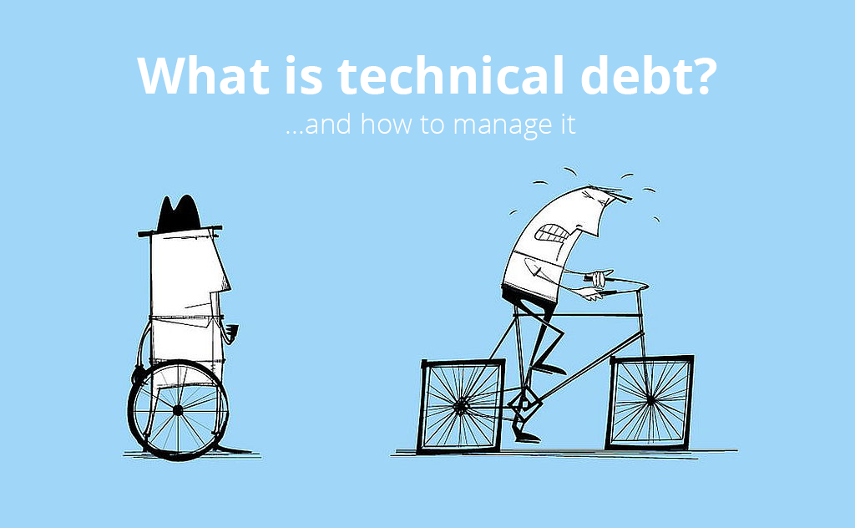
What is technical debt?

Slide 29
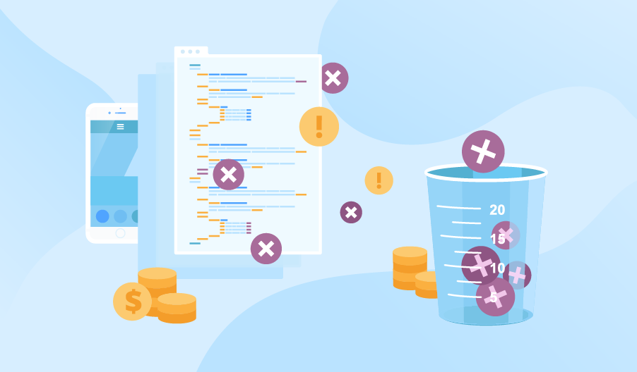
How it is measured?

Slide 30
How to reduce Technical Debt?
Simple Architecture (Passes the tests, Reveals Intention, No Duplication, Fewest Elements)
Continuous Refactoring
Good Unit Tests
TDD
Static Analysis
Good Standards
Peer Reviews
Fingers crossed (Nobody can predict future architecture and when current architecture becomes obselete)
Maintain a Technical Backlog
Do a cleanup spring once in a while!

Slide 31
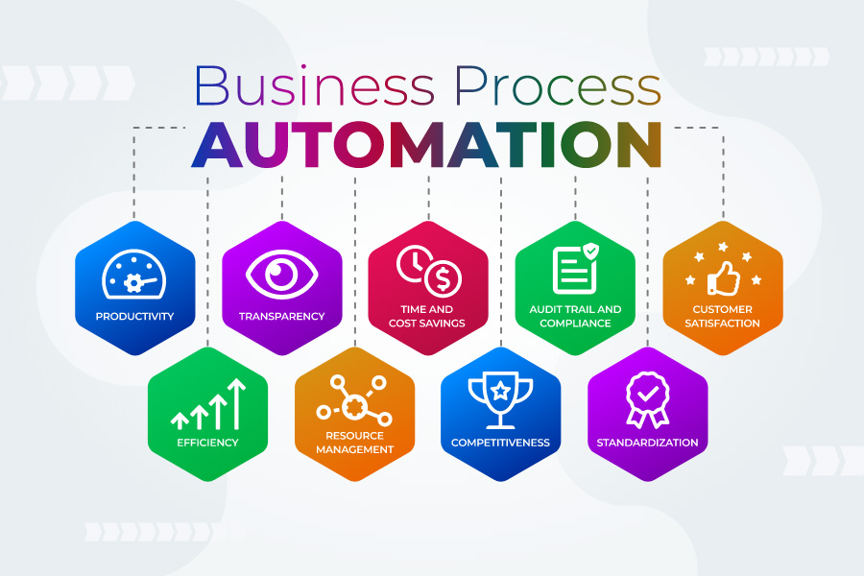

Slide 32
10 Best Practices to Automate Business Processes
Identify areas in need of functional improvement.
Find repetitive tasks.
Prioritize areas to automate.
Create a holistic plan.
Establish clear roles.
Create Standard operating procedures (SOPs).
Don’t forget business process management.
Train users.
Create a backup plan.
Leverage ERP software.

Slide 33
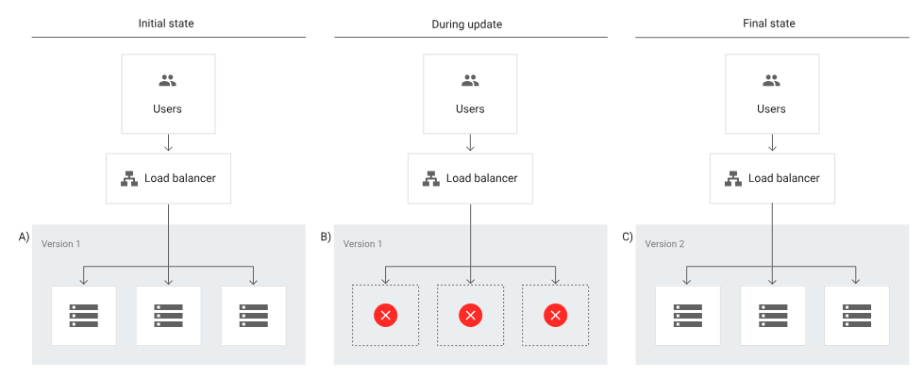


Slide 34
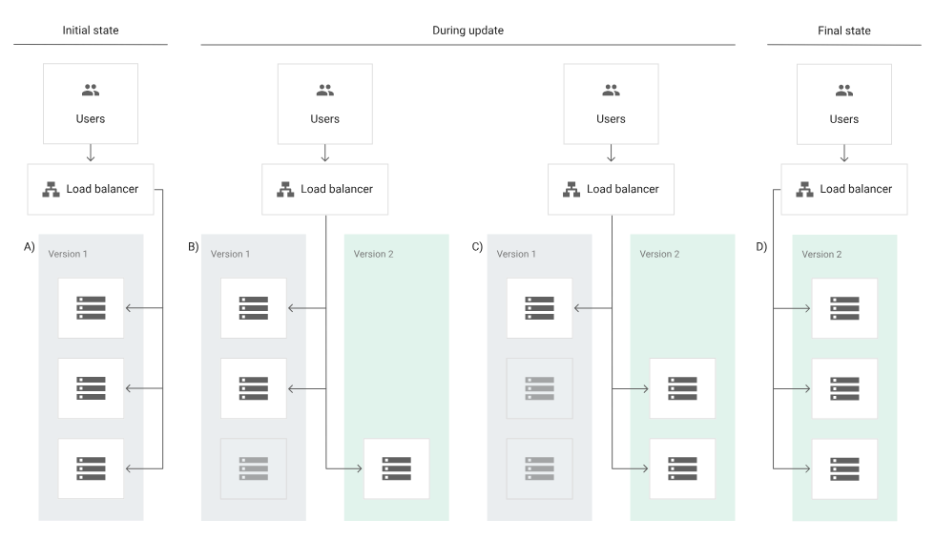

Slide 35
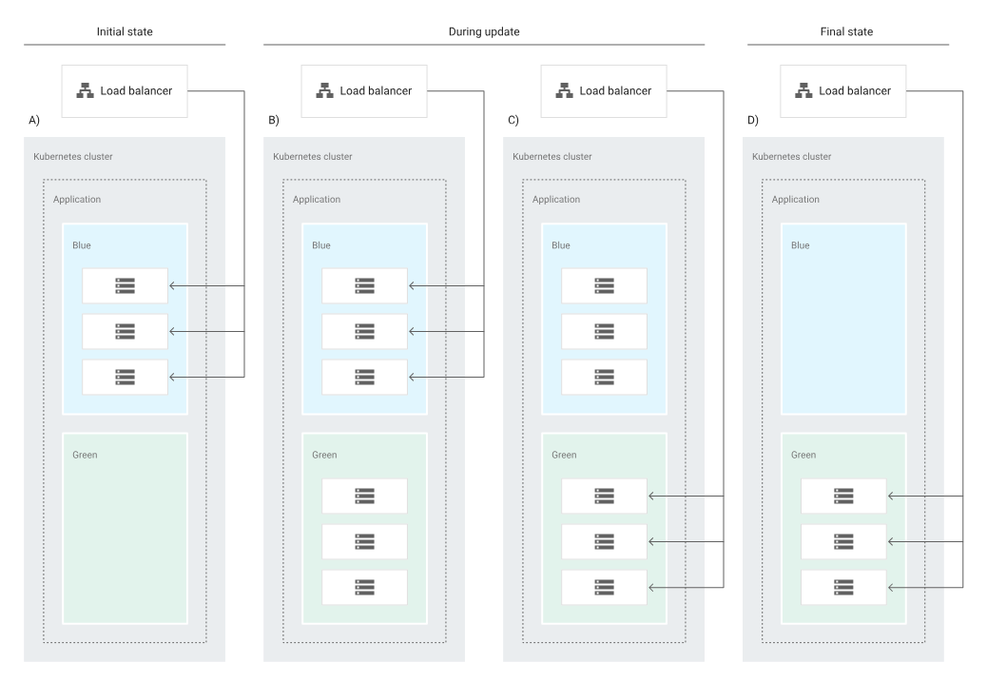

Slide 36
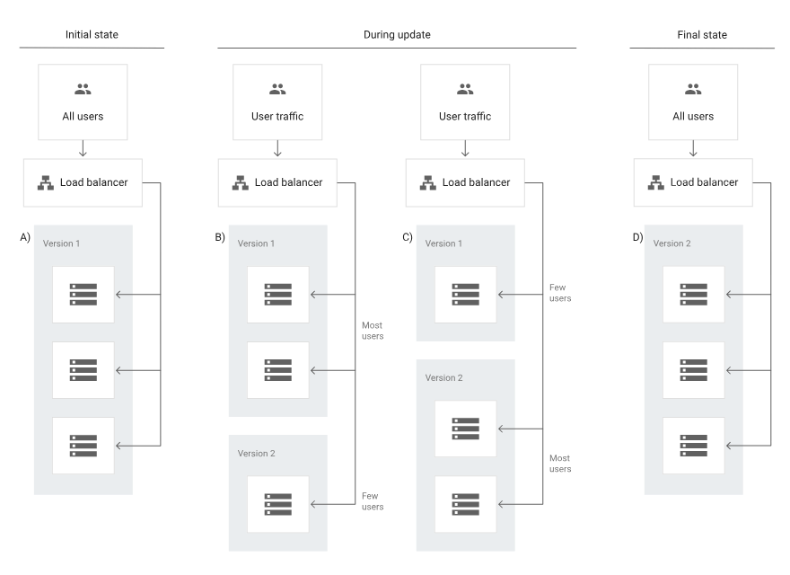

Slide 37
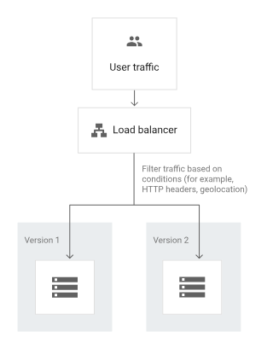

Slide 38
